Slide 1
This slide is hidden.
Insert the starting slides after this slide

Slide 2
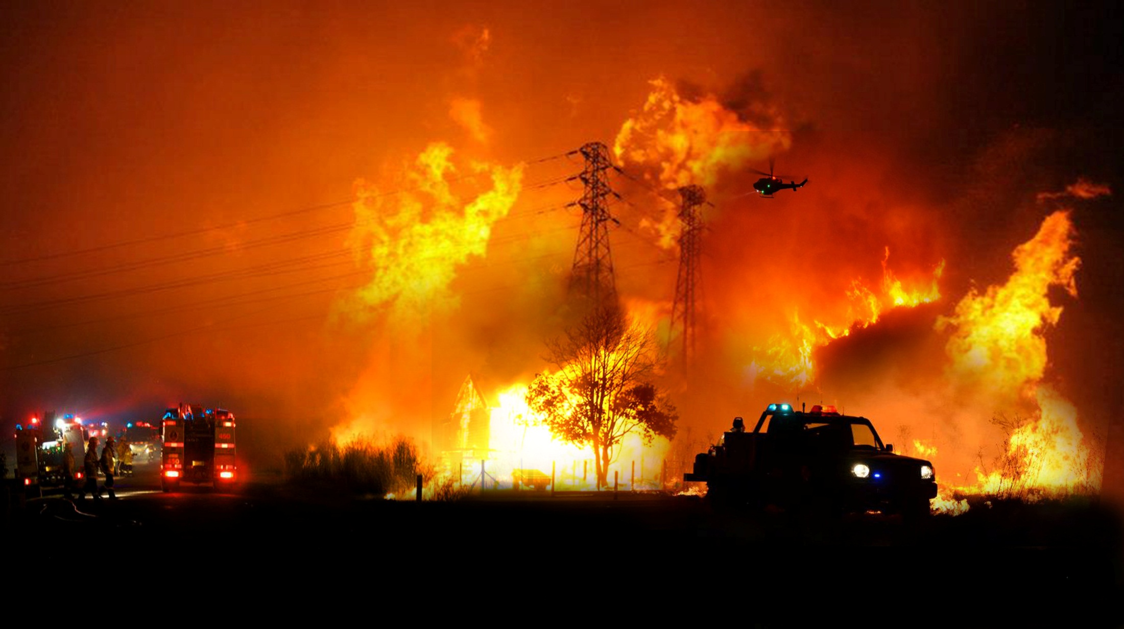
A number of communities in our Diocese have been devastated by fire in recent days …
at the conclusion of Mass there will be a bucket collection. We thank you for your generosity.

Slide 3

Welcome to St Michael’s
29th Sunday in Ordinary Time Year C
Mission Sunday
Please ensure all mobile phones are switched off.
Please be respectfully quiet as we prepare for our Celebration.
Notes:
Saturday 5.30PM First Sunday of Advent
7am - 22nd Sunday in Ordinary Time

Slide 4
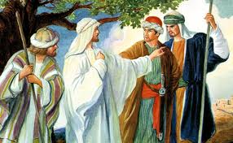
Jesus told his disciples a parable about the need to pray continually and never lose heart.

Slide 5
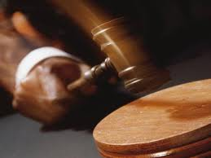
There was a judge in a certain town’, with neither respect for God or people..

Slide 6
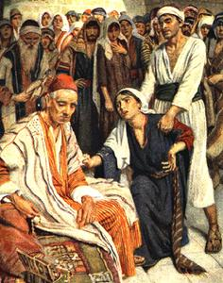
In the same town there was a widow who kept coming to him and saying, “I want justice from you…”

Slide 7
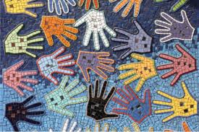
Have you ever raised your voice for the cause of justice? Has area of need or justice project ever caught your attention?

Slide 8
Please Stand

Slide 9
This slide is hidden.
Insert the Entrance Hymn after this slide

Slide 10
Praise the name of Jesus
Praise the name of Jesus
Praise him as we pray
Praise the name of Jesus
Sing to him all our days

Slide 11
From the rising of the sun
To the setting of the same
The name of the Lord is to be praised
In all things let's praise his name
And so let's

Slide 12
Praise the name of Jesus
Praise him as we pray
Praise the name of Jesus
Sing to him all our days

Slide 13
Let us come unto the Lord
Let us make a joyful noise
He has healed us through his word
In all things let's praise his name
And so let's

Slide 14
Praise the name of Jesus
Praise him as we pray
Praise the name of Jesus
Sing to him all our days
Sing to him all our days

Slide 16
Confiteor
I confess to almighty God
And to you, my brothers and sisters,
That I have greatly sinned
In my thoughts and in my words

Slide 17
In what I have done
And in what I have failed to do,
Through my fault,
Through my fault,
Through my most grievous fault;

Slide 18
Therefore I ask blessed Mary ever-Virgin,
All the Angels and Saints,
And you, my brothers and sisters,
To pray for me to the Lord our God.

Slide 20
Kyrie eleison
Kyrie eleison (2)
Christe eleison (2)
Kyrie eleison (2)

Slide 22
Glory to God
Glory to God in the highest,
And on earth peace to people of good will.
We praise you, we bless you,
We adore you, we glorify you

Slide 23
We give you thanks for your great glory,
Lord God heavenly King,
O God, almighty Father

Slide 24
Lord Jesus Christ, only begotten Son,
Lord God, Lamb of God,
Son of the Father,

Slide 25
You take away the sins of the world,
Have mercy on us;
You take away the sins of the world,
Receive our prayer;

Slide 26
You are seated
At the right hand of the Father
Have mercy on us

Slide 27
For you alone are the Holy One,
You alone are the Lord
You alone are the most High,
Jesus Christ

Slide 28
With the Holy Spirit,
In the glory of God the Father.
Amen!
Amen!

Slide 29
Gloria
Glory to God in the highest,
and on earth peace to people of good will.
We praise you, we bless you,
we adore you, we glorify you,

Slide 30
We give you thanks for your great glory,
Lord, God heavenly king,
O God, almighty father

Slide 31
Glory to God in the highest,
and on earth peace to people of good will.

Slide 32
Lord Jesus Christ, Only Begotten Son,
Lord God, Lamb of God, Son of the Father,
you take away the sins of the world,
have mercy on us;

Slide 33
you take away the sins of the world, receive our prayer;
you are seated at the right hand of the Father,
have mercy on us.

Slide 34
Glory to God in the highest,
and on earth peace to people of good will.

Slide 35
For you alone are the Holy One,
you alone are the Lord,
you alone are the Most High, Jesus Christ,
with the Holy Spirit,
in the glory of God the Father.

Slide 36
Glory to God in the highest,
and on earth peace to people of good will.
Amen.

Slide 38
Responsorial Psalm
Our help is from the Lord,
who made heaven and earth.

Slide 40
Alleluia
Alleluia, alleluia,
alleluia, alleluia
Alleluia, alleluia,
Alleluia alleluia.

Slide 42
Apostles Creed
I believe in God,
the Father almighty,
Creator of heaven and earth,
and in Jesus Christ, his only Son, our Lord,
(At the words that follow, up to and including the Virgin Mary, all bow.)

Slide 43
who was conceived by the Holy Spirit,
born of the Virgin Mary,
suffered under Pontius Pilate,
was crucified, died and was buried;
he descended into hell;

Slide 44
on the third day he rose again from the dead;
he ascended into heaven,
and is seated at the right hand of God the Father almighty;

Slide 45
from there he will come to judge the living and the dead.
I believe in the Holy Spirit,
the holy catholic Church,

Slide 46
the communion of saints,
the forgiveness of sins,
the resurrection of the body,
and life everlasting.
Amen.

Slide 48
First Collection
This collection goes to the Bishop
for the support of the Diocese.
Thank you for your contribution

Slide 50
This slide is hidden.
Insert the Offertory Hymn after this slide.

Slide 52
As the deer panteth
As the deer panteth for the water
So my soul longeth after thee
You alone are my heart’s desire
and I long to worship thee.

Slide 53
You alone are my strength my shield
To you alone may my spirit yield.
You alone are my heart’s desire
And I long to worship thee

Slide 54
I want you more than gold and silver
Only you can satisfy
You alone are the true joy giver
And the apple of my eye

Slide 55
You alone are my strength my shield
To you alone may my spirit yield.
You alone are my heart’s desire
And I long to worship thee

Slide 56
You are mine yes, you are my brother
Even though you are a King.
I love you more than any other
And much more than anything

Slide 57
You alone are my strength my shield
To you alone may my spirit yield.
You alone are my heart’s desire
And I long to worship thee

Slide 59
Priest: Pray my brothers and sisters,
that my sacrifice and yours may be
acceptable to God, the almighty Father.
All: May the Lord accept the sacrifice
at your hands for the praise and glory of his name, for our good and the good of all his holy Church.

Slide 60
Priest: The Lord be with you.
All: And with your spirit.
Priest: Lift up your hearts.
All: We lift them up to the Lord.

Slide 61
Priest: Let us give thanks to the
Lord our God.
All: It is right and just.

Slide 63
Holy
Holy, Holy, Holy Lord God of hosts,
Heaven and earth are full of your glory. Hosanna in the highest
Blessed is he who comes
in the name of Lord,
Hosanna in the highest.

Slide 65
Memorial acclamation
Save us saviour of the world,
For by your cross and resurrection,
You have set us free

Slide 66
Memorial acclamation
When we eat this bread
And drink this cup
We proclaim your death O Lord
Until you come again

Slide 67
Memorial acclamation
We proclaim your death O Lord
And profess your resurrection
Until you come again

Slide 69
Amen
Amen, amen.
Amen, amen.

Slide 71
Priest: The Lord be with you.
All: And with your spirit

Slide 73
Peace
May the peace of the Lord be with you
With your friends and your family too
Let it be, let it grow
And everywhere you go
May the peace of the Lord follow you

Slide 74
Lamb of God
Lamb of God
You take away the sins of the world
Have mercy on us.

Slide 75
Lamb of God
You take away the sins of the world
Have mercy on us

Slide 76
Lamb of God
You take away the sins of the world
Grant us peace

Slide 78
All: Lord, I am not worthy
that you should enter under my roof,
but only say the word
and my soul shall be healed.

Slide 80
Priest: Behold the Lamb of God,
behold him who takes away the sins of the world. Blessed are those called to
the supper of the Lamb.
All: Lord, I am not worthy
that you should enter under my roof,
but only say the word
and my soul shall be healed.

Slide 81
This slide is hidden.
Insert the Communion Hymns after this slide.

Slide 82
Alpha and Omega
You are my God,
My alpha and omega,
You are the author
The perfector of my faith.
In you I have my all, in all.

Slide 83
You are my God,
My alpha and omega,
You are the author
The perfector of my faith.
In you I have my all, in all.

Slide 84
Shalom, Shalom, the Lord is peace,
Shalom, Shalom, we’ll live in thee,
May the Lord keep you
and cause his face to shine on you,
Shalom, Shalom.

Slide 85
Jesus my Lord, my God, my all
Jesus, my Lord, my God, my all!
How can I love Thee as I ought?
And how revere this wondrous gift,
So far surpassing hope or thought?

Slide 86
Sweet Sacrament, we Thee adore!
Oh, make us love Thee more and more.
Oh, make us love Thee more and more.

Slide 87
Had I but Mary's sinless heart
With which to love Thee, dearest King,
Oh, with what ever fervent praise,
Thy goodness, Jesus, would I sing!

Slide 88
Sweet Sacrament, we Thee adore!
Oh, make us love Thee more and more.
Oh, make us love Thee more and more.

Slide 89
Thy Body, Soul and Godhead, all!
O mystery of love divine!
I cannot compass all I have,
For all Thou hast and art is mine!

Slide 90
Sweet Sacrament, we Thee adore!
Oh, make us love Thee more and more.
Oh, make us love Thee more and more.

Slide 91
Christ be beside me
Christ be beside me,
Christ be before me
Christ be behind me,
King of my heart

Slide 92
Christ be within me,
Christ be below me
Christ be above me,
never to part

Slide 93
Christ on my right hand,
Christ on my left hand
Christ all around me,
shield in the strife

Slide 94
Christ in my sleeping,
Christ in my sitting
Christ in my rising,
light of my life

Slide 95
Christ be in all hearts
thinking about me
Christ be on all tongues
telling of me

Slide 96
Christ be the vision
in eyes that see me
In ears that hear me,
Christ ever be.

Slide 97
Second Collection
What you contribute now
is for the support of our
parish and its mission.
Thank you for your generosity

Slide 98
This slide is hidden.
Insert the Notices for the week after this slide

Slide 99
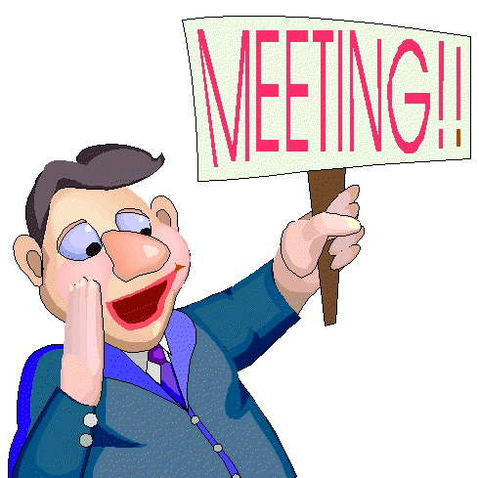
PPC MEETING
(Parish Pastoral Council)
Tuesday 22 October 7.30PM
Parish Centre
All Welcome!

Slide 100
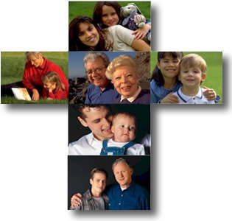
Formation Opportunities
Liturgical Ministries
Tuesday 29 October 2013
7.30pm St Michael’s Parish Centre
Sunday 24 November 2013
2.00 pm Institute for Mission
RSVP – Parish Office

Slide 101

NOVEMBER MASS OFFERINGS
Names recorded in Book of Remembrance and remembered at all Masses during November.

Slide 102

The SVDP pantry needs to restock the following items:
Pasta Sauce; Tinned Fruit; Tinned Meat (Corned Beef/Ham) Tinned Spaghetti and Biscuits.
Many thanks for your support

Slide 103

Please take home your bulletins or download it from
www.stmichaelsparish.com
  www.facebook.com/
  blacktowncatholics

Slide 104
This slide is hidden.
The next slide can be used for videos.
Insert the video into the slide.

Slide 106
Priest: The Lord be with you.
All: And with your spirit.

Slide 108
This slide is hidden.
Insert the Recessional Hymns after this slide.

Slide 109
Step into the sunshine
Step into the sunshine,
Get out of the shade
This is the one time that you’ve got it made,

Slide 110
And you can…feel yourself smilin’
Way down to your shoes
Step into the sunshine,
find the great good news.

Slide 111
Lord have mercy on the long, lost child,
Who wants to come home,
But the world’s gone wild
(world’s gone wild).

Slide 112
Lookin’ all around for a way to begin,
“Open up the windows, let the light pour in (light pour in)!”
I said, “Open up the windows let the light pour in.”

Slide 113
Why don't you step into the sunshine,
Get out of the shade
This is the one time that you’ve got it made,

Slide 114
And you can…feel yourself smilin’
Way down to your shoes
Step into the sunshine,
find the great good news.

Slide 115
Lord have mercy on the broken man,
Make him wake up believing’
yes he can (yes he can)!

Slide 116
If he only will try it to make it just once more,
Prayin’ will open that golden door
(golden door)!
I said, “Prayin’ will open up that golden.

Slide 117
Why don't you step into the sunshine,
Get out of the shade
This is the one time that you’ve got it made,

Slide 118
And you can…feel yourself smilin’
Way down to your shoes
Step into the sunshine, find the great good news.

Slide 119
Have you ever raised your voice for the cause of justice? Has area of need or justice project ever caught your attention?

Slide 120
A number of communities in our Diocese have been devastated by fire in recent days …
at the conclusion of Mass there will be a bucket collection. We thank you for your generosity.

Slide 121
This slide is hidden.
Insert the final slide here.

